Slide 1

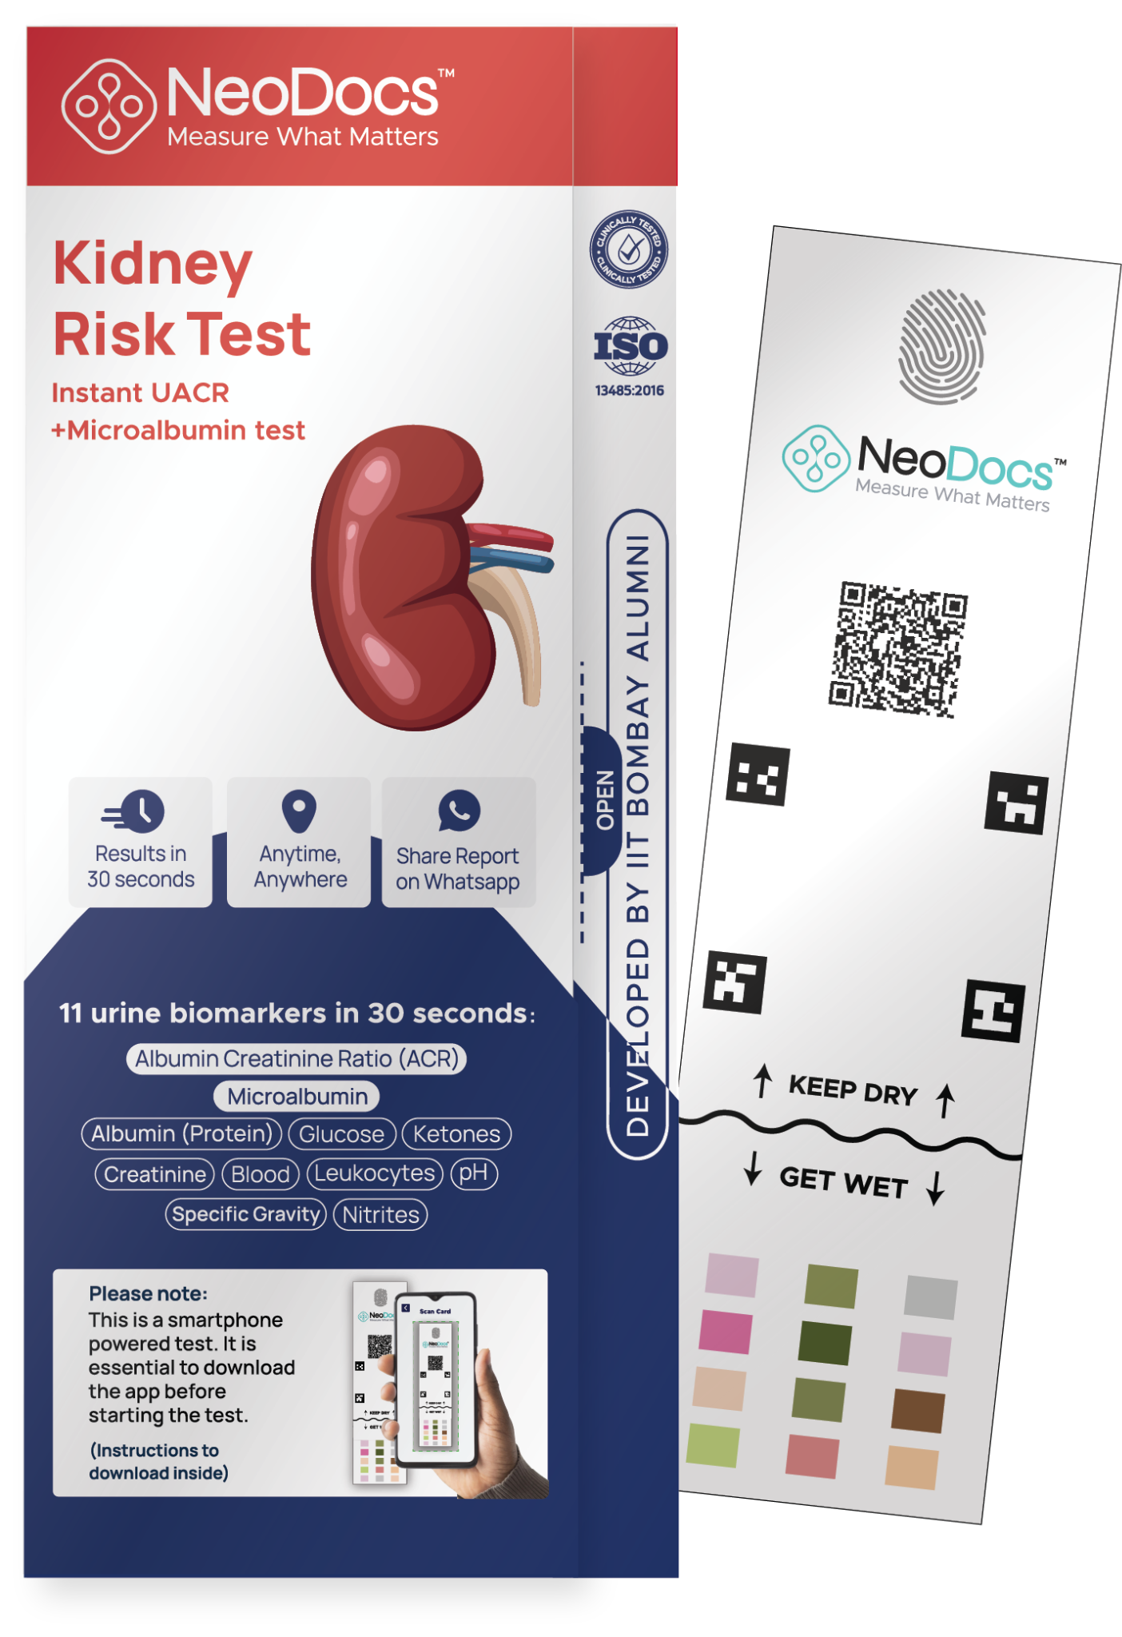


MONTHLY UPDATE - UACR CAMPS
Instant UACR on any phone
In-clinic + At-home

Slide 2
Overview
High-level summary of testing performance
Total Tests
Total Camps
Total Doctors
2,227
711
351
A2+A3 Abnormality
States Covered
25%
22
Neodocs YCS21 • Confidential • Pharma Insights Report
1

Slide 3
State Wise Testing (Till November 2025)
State | Total Tests | Total Camps | A1 | A2 | A3 | Abnormality %
Kerala | 462 | 57 | 330 | 68 | 64 | 30%
Maharashtra | 335 | 126 | 282 | 43 | 10 | 17%
Tamil Nadu | 281 | 78 | 228 | 45 | 8 | 19%
Telangana | 214 | 68 | 163 | 45 | 6 | 24%
Delhi | 183 | 74 | 131 | 39 | 13 | 30%
Uttar Pradesh | 160 | 63 | 123 | 24 | 13 | 23%
Gujarat | 132 | 40 | 101 | 23 | 8 | 25%
Karnataka | 115 | 70 | 80 | 23 | 12 | 40%
Uttarakhand | 57 | 8 | 54 | 3 | 0 | 5%
West Bengal | 51 | 8 | 28 | 15 | 8 | 45%
Odisha | 50 | 19 | 36 | 3 | 11 | 28%
Andhra Pradesh | 39 | 12 | 28 | 8 | 3 | 28%
Haryana | 31 | 19 | 27 | 4 | 0 | 16%
Neodocs YCS21 • Confidential • Pharma Insights Report
2

Slide 4
City Wise Testing (Till November 2025)
Orgcity | Total Tests | Total Camps | A1 | A2 | A3 | Abnormality %
Kozhikode | 233 | 25 | 141 | 38 | 54 | 40%
Delhi | 183 | 74 | 131 | 39 | 13 | 30%
Hyderabad | 155 | 57 | 119 | 31 | 5 | 23%
Chennai | 152 | 40 | 129 | 18 | 5 | 15%
Kolhapur | 105 | 14 | 89 | 12 | 4 | 16%
Ahmedabad | 80 | 3 | 65 | 14 | 1 | 18%
Thiruvananthapuram | 77 | 10 | 62 | 12 | 3 | 23%
Bengaluru | 58 | 31 | 42 | 16 | 0 | 39%
Malappuram | 56 | 4 | 43 | 9 | 4 | 23%
Salem | 55 | 11 | 48 | 6 | 1 | 12%
Vellore | 52 | 15 | 31 | 19 | 2 | 42%
Pune | 52 | 23 | 46 | 6 | 0 | 11%
Nizamabad | 48 | 3 | 37 | 11 | 0 | 22%
Haldwani | 48 | 6 | 45 | 3 | 0 | 6%
Calicut | 44 | 2 | 41 | 3 | 0 | 6%
Neodocs YCS21 • Confidential • Pharma Insights Report
3

Slide 5
Speciality Wise Testing (Till November 2025)
Specialization | Total Tests | Total Camps | A1 | A2 | A3 | Abnormality %
General Physician | 678 | 236 | 530 | 103 | 45 | 23%
Nephrologist | 578 | 175 | 391 | 98 | 89 | 33%
Diabetologist | 443 | 137 | 354 | 65 | 24 | 22%
Internal Medicine | 299 | 87 | 238 | 56 | 5 | 22%
Cardiologist | 150 | 48 | 126 | 20 | 4 | 17%
Endocrinologist | 50 | 14 | 38 | 11 | 1 | 24%
Others | 29 | 14 | 24 | 3 | 2 | 31%
Neodocs YCS21 • Confidential • Pharma Insights Report
4

Slide 6
Age Group Testing (Till November 2025)
Age Group | Total Tests | A1 | A2 | A3 | Abnormality %
<30 | 337 | 252 | 54 | 31 | 29%
30-40 | 333 | 276 | 38 | 19 | 18%
40-50 | 429 | 329 | 73 | 27 | 24%
50-60 | 524 | 414 | 73 | 37 | 21%
60-70 | 377 | 278 | 66 | 33 | 27%
70-80 | 178 | 124 | 41 | 13 | 31%
80-90 | 46 | 28 | 9 | 9 | 43%
>90 | 1 | 0 | 1 | 0 | 100%
Neodocs YCS21 • Confidential • Pharma Insights Report
5

Slide 7
Gender Wise Testing (Till November 2025)
Gender | Total Tests | A1 | A2 | A3 | Abnormality %
Male | 1430 | 1082 | 224 | 124 | 26%
Female | 797 | 619 | 132 | 46 | 23%
Neodocs YCS21 • Confidential • Pharma Insights Report
6

Slide 8
November 2025 Insights
01-11-2025 to 30-11-2025
Neodocs YCS21 • Confidential • Pharma Insights Report
7

Slide 9
November 2025 Overview
High-level summary of testing performance
Total Tests
Total Camps
Total Doctors
363
92
51
A2+A3 Abnormality
States Covered
26%
15
Neodocs YCS21 • Confidential • Pharma Insights Report
8

Slide 10
State Wise Testing (November 2025)
State | Total Tests | Total Camps | A1 | A2 | A3 | Abnormality %
Kerala | 118 | 6 | 85 | 19 | 14 | 27%
Maharashtra | 85 | 22 | 72 | 9 | 4 | 15%
Tamil Nadu | 35 | 11 | 29 | 5 | 1 | 17%
Uttar Pradesh | 26 | 12 | 23 | 3 | 0 | 11%
West Bengal | 26 | 3 | 9 | 13 | 4 | 65%
Gujarat | 14 | 10 | 6 | 3 | 5 | 57%
Delhi | 13 | 3 | 7 | 5 | 1 | 46%
Andhra Pradesh | 12 | 2 | 9 | 2 | 1 | 25%
Karnataka | 8 | 7 | 6 | 2 | 0 | 25%
Telangana | 8 | 7 | 7 | 1 | 0 | 12%
Madhya Pradesh | 7 | 1 | 7 | 0 | 0 | 0%
Rajasthan | 6 | 3 | 6 | 0 | 0 | 0%
Assam | 2 | 2 | 1 | 1 | 0 | 50%
Neodocs YCS21 • Confidential • Pharma Insights Report
9

Slide 11
City Wise Testing (November 2025)
Orgcity | Total Tests | Total Camps | A1 | A2 | A3 | Abnormality %
Malappuram | 51 | 2 | 38 | 9 | 4 | 25%
Calicut | 40 | 1 | 38 | 2 | 0 | 5%
Kolhapur | 36 | 7 | 29 | 5 | 2 | 19%
Malegaon | 26 | 1 | 23 | 2 | 1 | 11%
Bankura | 24 | 2 | 7 | 13 | 4 | 70%
Kozhikode | 24 | 2 | 6 | 8 | 10 | 75%
Vellore | 20 | 7 | 15 | 4 | 1 | 25%
Salem | 15 | 4 | 14 | 1 | 0 | 6%
Delhi | 13 | 3 | 7 | 5 | 1 | 46%
Navsari | 13 | 9 | 6 | 3 | 4 | 53%
Pune | 10 | 8 | 9 | 1 | 0 | 10%
Rajahmundry | 8 | 1 | 7 | 0 | 1 | 12%
Bengaluru | 7 | 6 | 5 | 2 | 0 | 28%
Gwalior | 7 | 1 | 7 | 0 | 0 | 0%
Bareilly | 6 | 2 | 6 | 0 | 0 | 0%
Neodocs YCS21 • Confidential • Pharma Insights Report
10

Slide 12
Speciality Wise Testing (November 2025)
Specialization | Total Tests | Total Camps | A1 | A2 | A3 | Abnormality %
General Physician | 134 | 49 | 96 | 26 | 12 | 28%
Diabetologist | 105 | 18 | 90 | 13 | 2 | 14%
Nephrologist | 94 | 11 | 58 | 21 | 15 | 38%
Internal Medicine | 23 | 10 | 18 | 4 | 1 | 21%
Others | 7 | 4 | 7 | 0 | 0 | 0%
Neodocs YCS21 • Confidential • Pharma Insights Report
11

Slide 13
Age Group Testing (November 2025)
Age Group | Total Tests | A1 | A2 | A3 | Abnormality %
<30 | 32 | 23 | 5 | 4 | 28%
30-40 | 31 | 28 | 2 | 1 | 9%
40-50 | 74 | 56 | 12 | 6 | 24%
50-60 | 98 | 75 | 15 | 8 | 23%
60-70 | 85 | 64 | 16 | 5 | 24%
70-80 | 32 | 20 | 9 | 3 | 37%
80-90 | 9 | 3 | 4 | 2 | 66%
Neodocs YCS21 • Confidential • Pharma Insights Report
12

Slide 14
Gender Wise Testing (November 2025)
Gender | Total Tests | A1 | A2 | A3 | Abnormality %
Male | 206 | 149 | 37 | 20 | 27%
Female | 157 | 120 | 27 | 10 | 23%
Neodocs YCS21 • Confidential • Pharma Insights Report
13

Slide 15
For more insights, login here:
https://ckddashboard.neodocs.in/

Slide 16
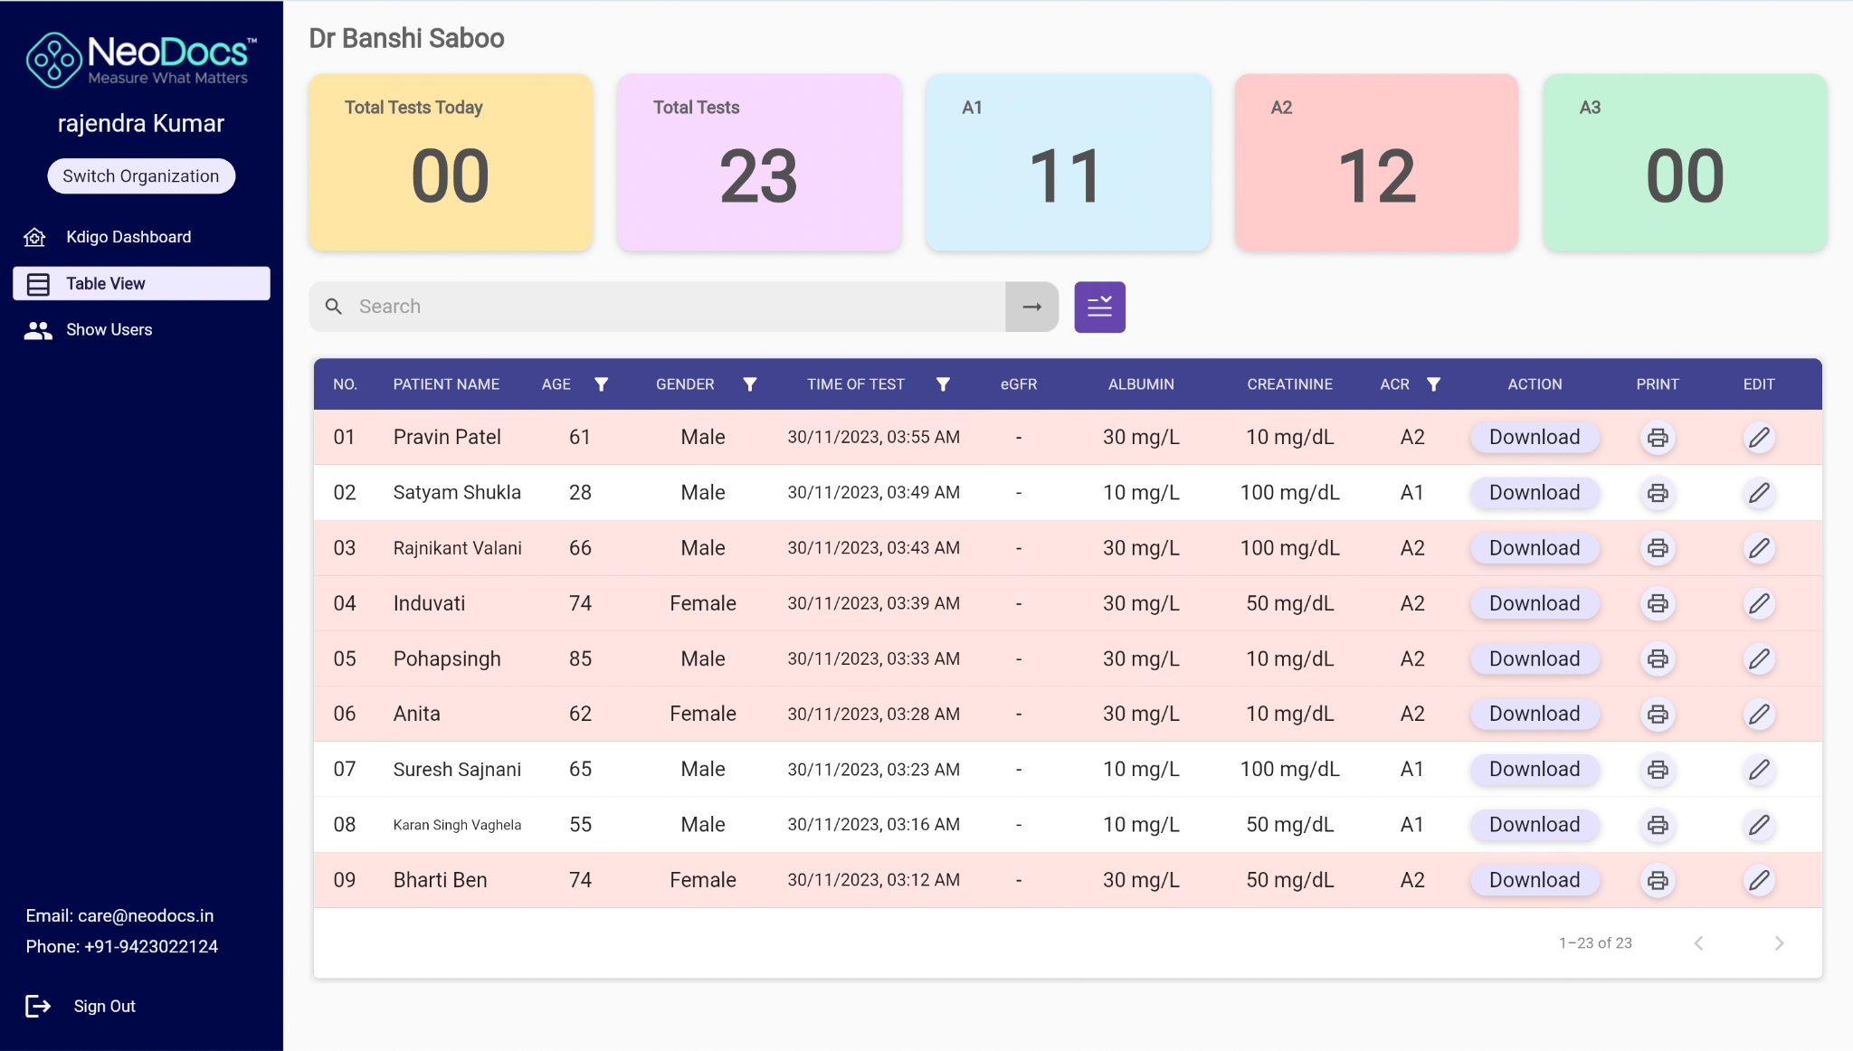
Doctor / Clinic Dashboard
Doctors can login on laptop / desktop for easy access
Can view, print and download report
Clinic level Kdigo Map
Clinic Users (doctor or staff) info
Multi-organization access function
Data filter by age, gender, date, ACR etc.
https://clinic.neodocs.in/

Slide 17
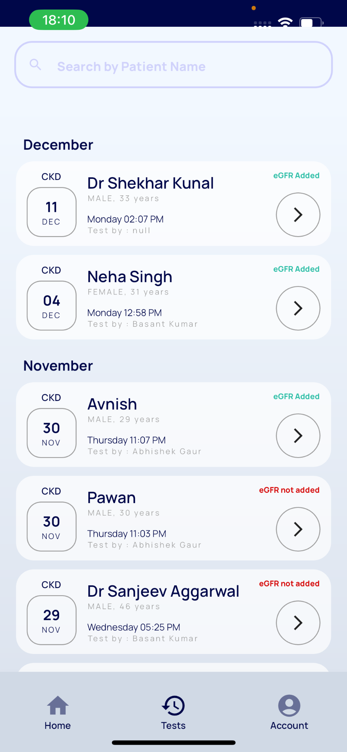
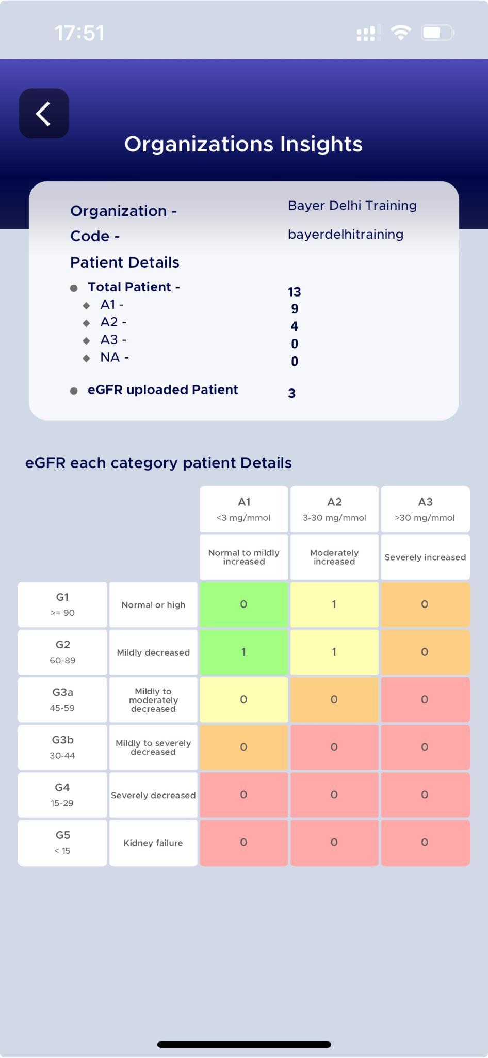
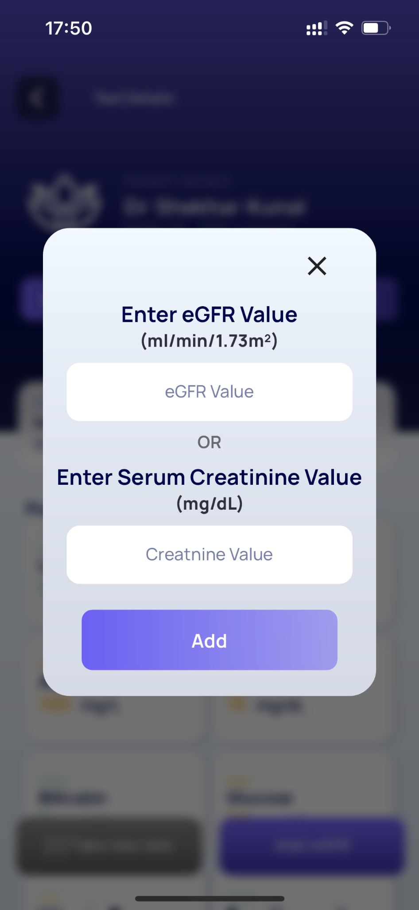
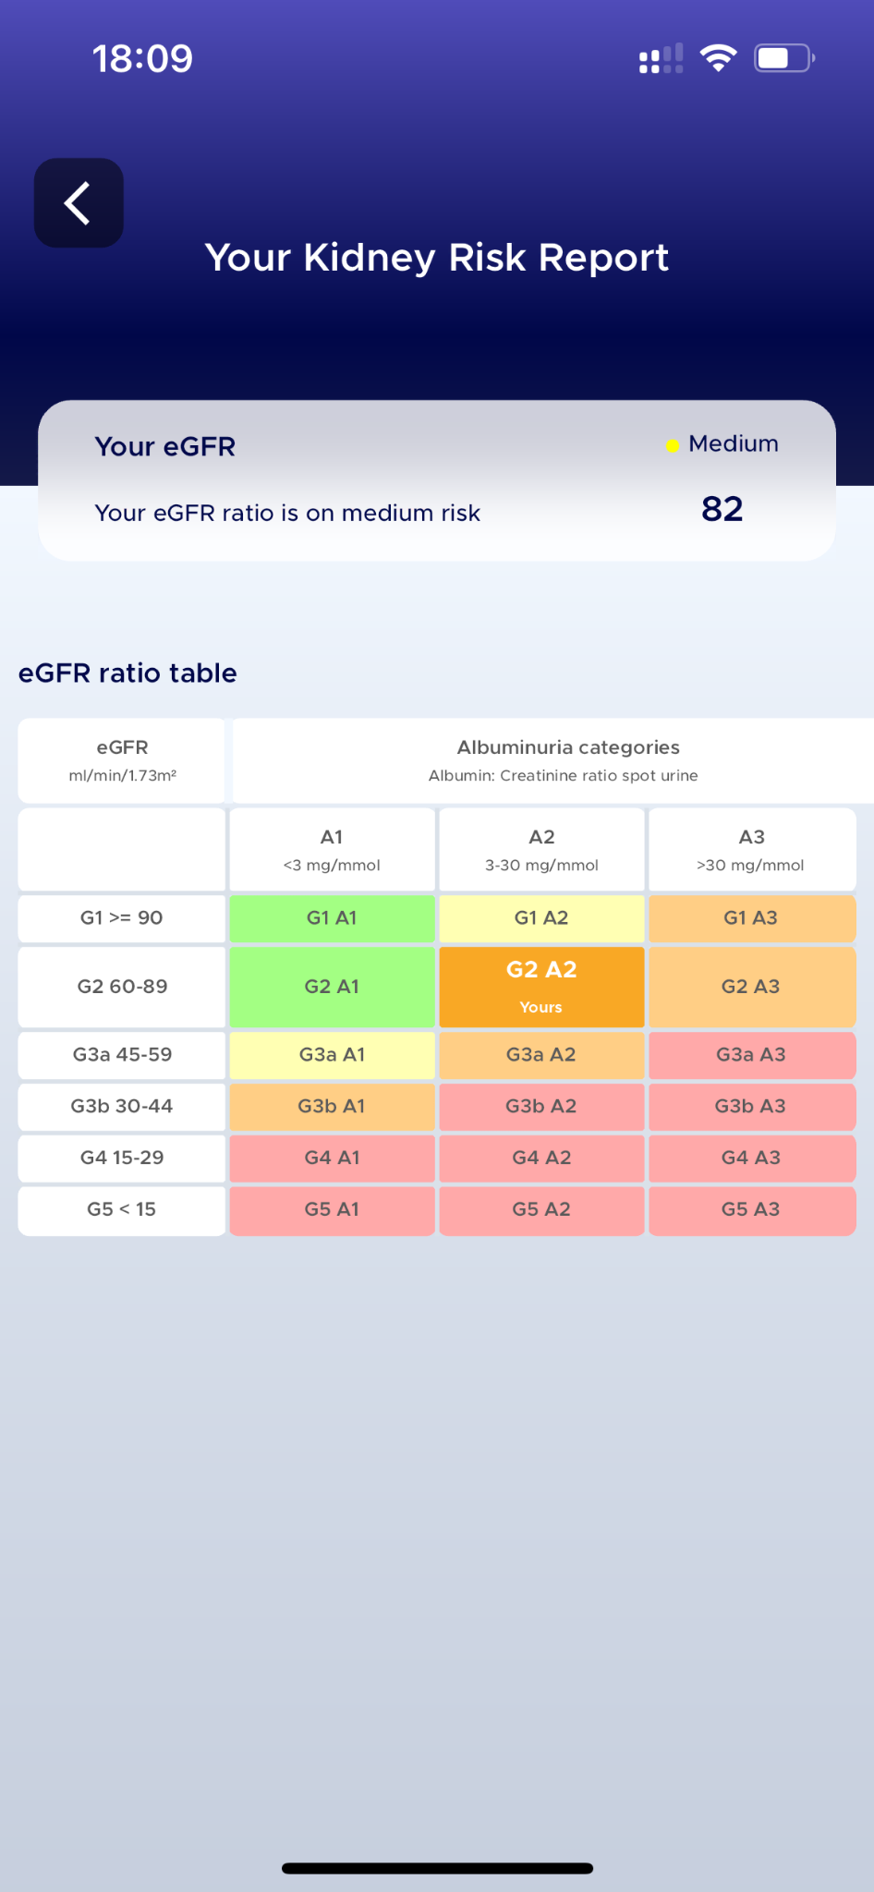
Features: Dr-NeoDocs App Dashboard

Slide 18
Thank you!
Contact Us:
Rajendra Bhaskar +91 99873 39111
Notes:
DON’T FORGET TO SET NEXT STEPS BEFORE LEAVING THE MEETING!

